Slide 1

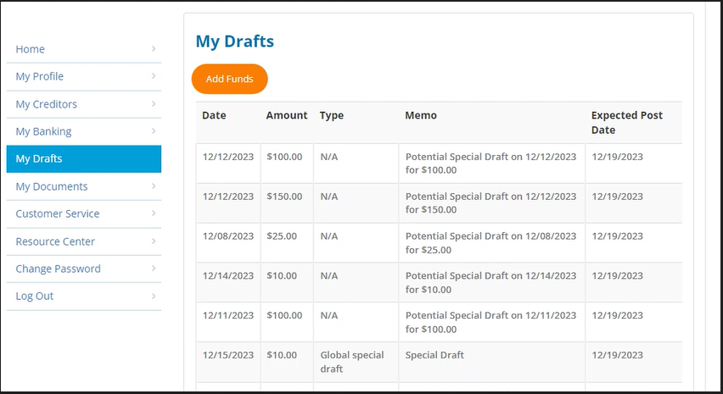
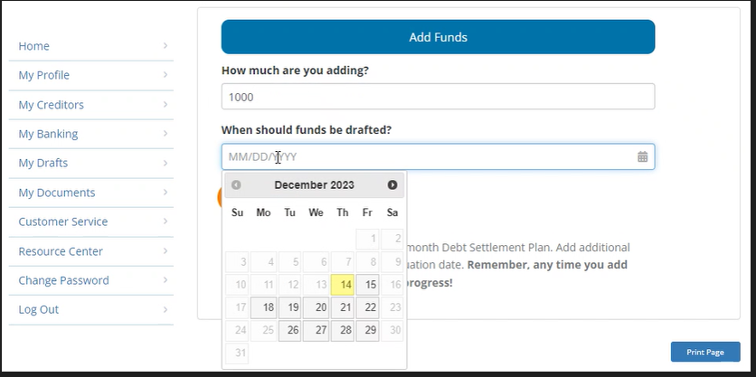
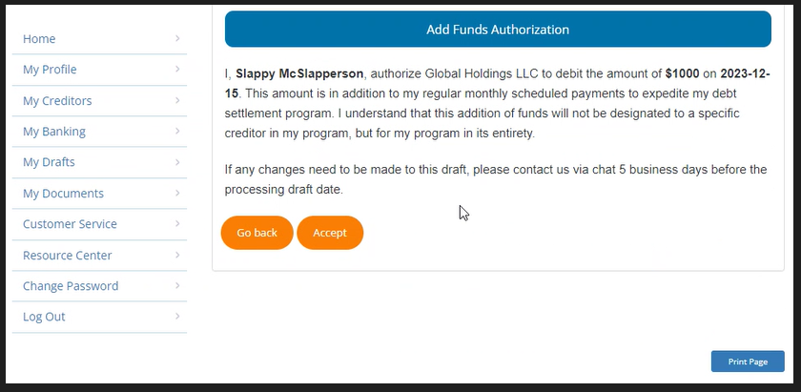
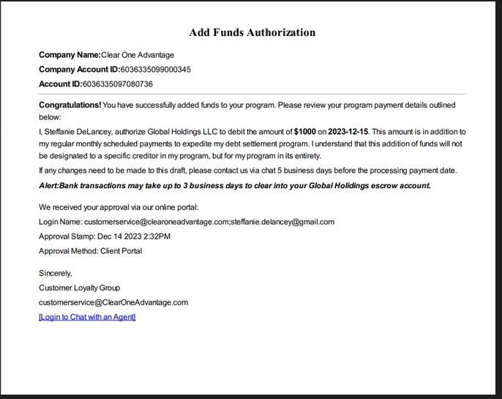
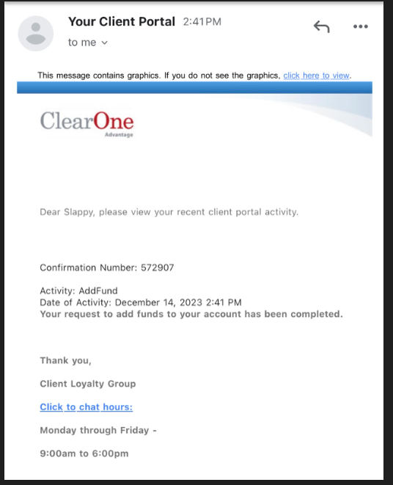
Confidential
Portal add funds client walkthrough
Step 1
Step 2
Click the “Add Fund” button to add drafts outside of their recurring scheduled drafts,
Can add funds up to $10,000 in funds.
The date set at least 5 days out.
Can print the page if they prefer.
Click “Continue” button once complete
Step 3
Step 4
Step 5
Will receive confirmation once completed.
confirmation email.
Read the disclosure and click on “Accept” to complete the add funds process.

